Slide 1
Comprehensive Analysis of Real Estate Market
Distributed & Scalable Data Engineering -TEAM-08

Slide 2



TEAM Members
Sai Siddu Vardhan Reddy Annadi
Team Leader(Data Scientist)
Vinay Kumar Reddy Punuru
(ML Engineer)
Shiva Priya Pillalamarri
(Data Engineer)

Slide 3

Business Scenario Overview
The residential real estate market has always been driven by a combination of multiple factors such as property size, amenities, location, and neighborhood characteristics. However, the COVID-19 pandemic has introduced new dynamics that have altered the way buyers and investors value properties. The pandemic has shifted lifestyle preferences, with more emphasis placed on remote work, suburban living, and proximity to health facilities, parks, and recreational spaces.

Slide 4

Solution Overview
This project aims to identify the key factors influencing residential property prices, including the impact of COVID-19, using the CAMA dataset from Open Data DC. By employing the CRISP-DM methodology, the project will explore property characteristics, neighborhood factors, and proximity to city centers to analyze price variations. Multilevel modeling will be used to evaluate differences in residential complexes, while answering specific questions on gross building area changes, the impact of COVID-19, and correlations between bedrooms and sale prices. The project will leverage data science tools and GitHub for collaboration to derive actionable insights.
Data : https://opendata.dc.gov/datasets/DCGIS::computer-assisted-mass-appraisal-residential/explore

Slide 5
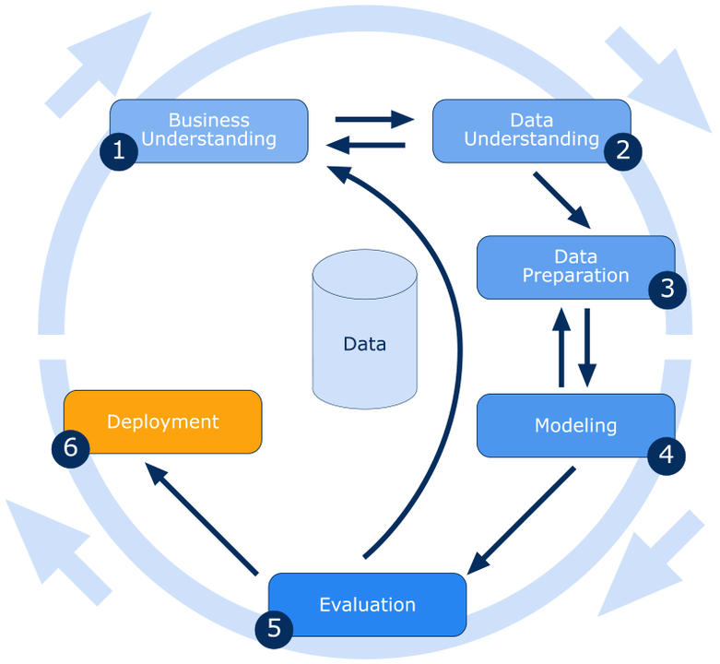
crisp methodology

Slide 6





Architecture:
Data Ingestion, Data Storage
Data Processing
CAMA Database
Model Deployment
Data Visualization

Slide 7
1. Data Ingestion:
• Data is sourced from databases or data lakes.
• This data is then stored in Amazon S3
2. Data Storage:
• Amazon Athena is used to query and analyze the data directly stored in Amazon S3. Athena enables running SQL queries on this data without managing a data warehouse.
3. Data Processing:
• The processed data is prepared for machine learning using Amazon SageMaker, which is used for building, training, and deploying machine learning models.
4. Model Deployment:
• The models are deployed using Amazon EC2 instances to perform inferences on the prepared data.
• Additionally, AWS Glue is used to handle ETL (Extract, Transform, and Load) processes, transforming data between various sources and destinations.
5. Data Visualization:
• Results from the analysis, such as property sales trends and prices, are visualized for interpretation and reporting.
Github: https://github.com/siddureddy-DS/Team08-DSCI-6007-01

Slide 8

Thank You

